Slide 1
LA Workshop Introduction
the world’s open source learning platform
Michael de Raadt @Salvetore
@MoodleResearch

Slide 2
About me

Slide 3
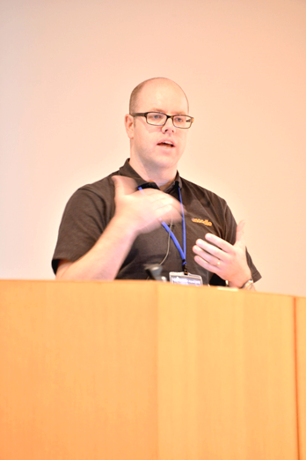
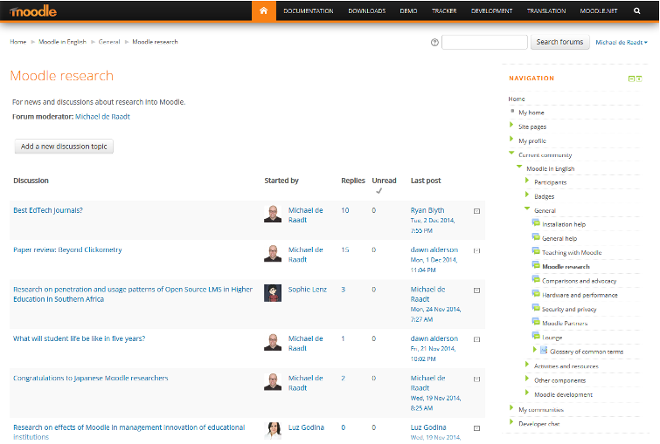
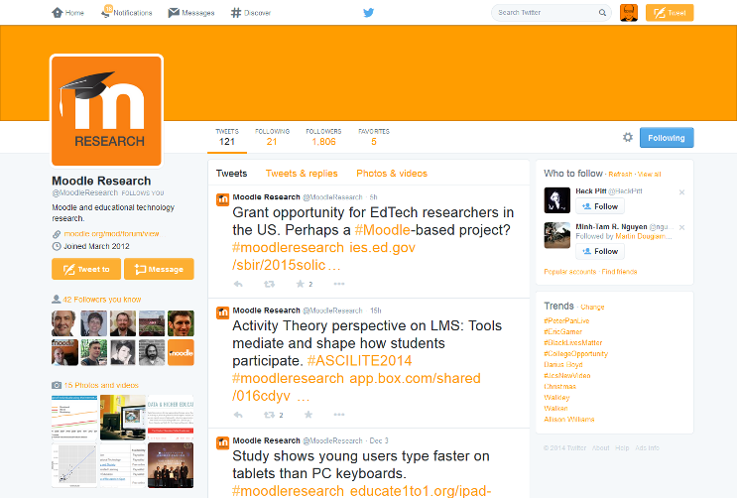
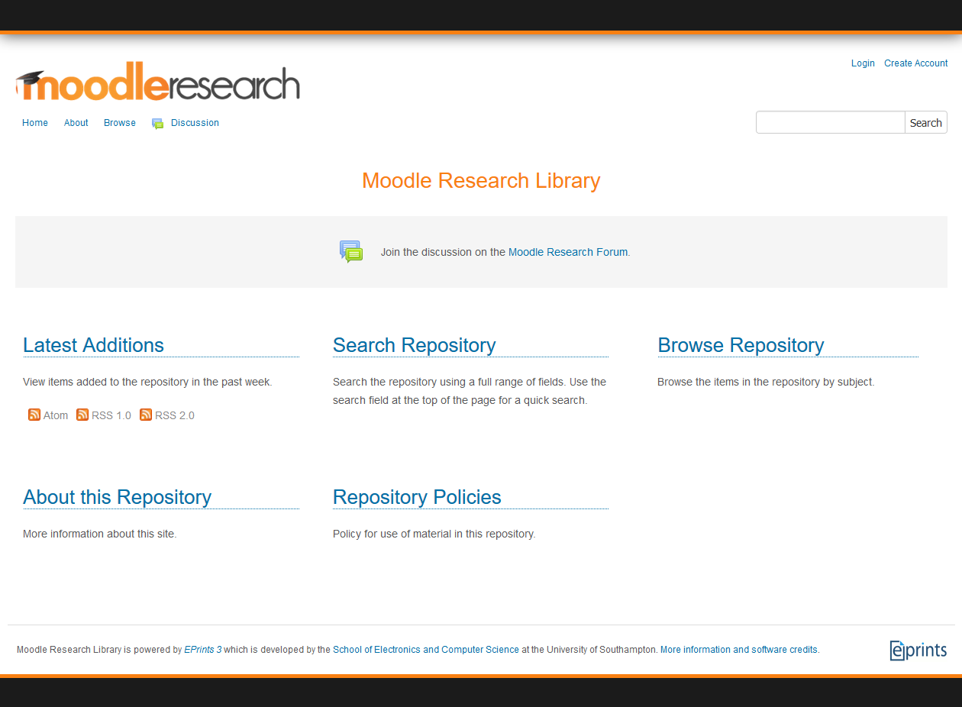
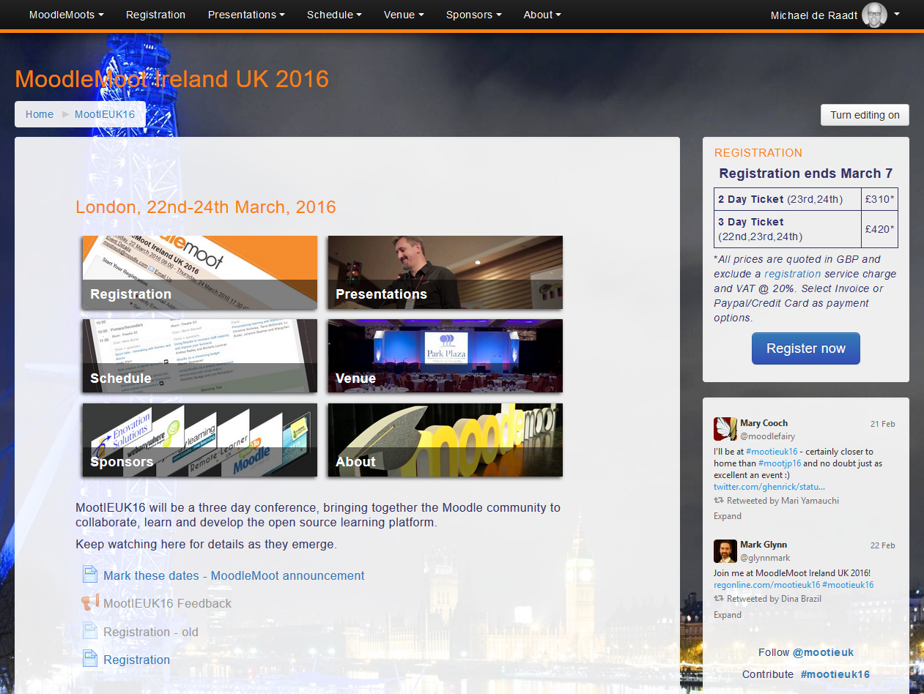

Slide 4
Introductions
Who are you?
Where are you from?
What is your role?
Why are you here?

Slide 5
What are Learning Analytics?
“The collection and analysis of usage data associated with student learning… for alerting faculty, students, and advisors when intervention is needed; providing input for continuous improvement in course design and delivery; and enabling personalization of the learning environment” (Brown, 2012).
Learning Analytics are any piece of information that can help an LMS user improve learning outcomes.

Slide 6
What are Learning Analytics?
Can measure
engagement
interaction
performance
progress
course quality
teacher involvement

Slide 7
What are Learning Analytics?
Can be
descriptive (what?)
diagnostic (why?)
predictive (what next?)
proactive (do this)
used, not just useful

Slide 8
Outline of sessions today
Perspectives
Student
Teacher
Decision-maker/Support
External analysis
Today: practical
https://docs.moodle.org/en/Learning_analytics

