Slide 1
Citation and referencing – is our training working?
Dr Mark Glynn
Jack Hyland

Slide 2
Outline
Background
How we used Moodle
Analysis
Results
Conclusions

Slide 3
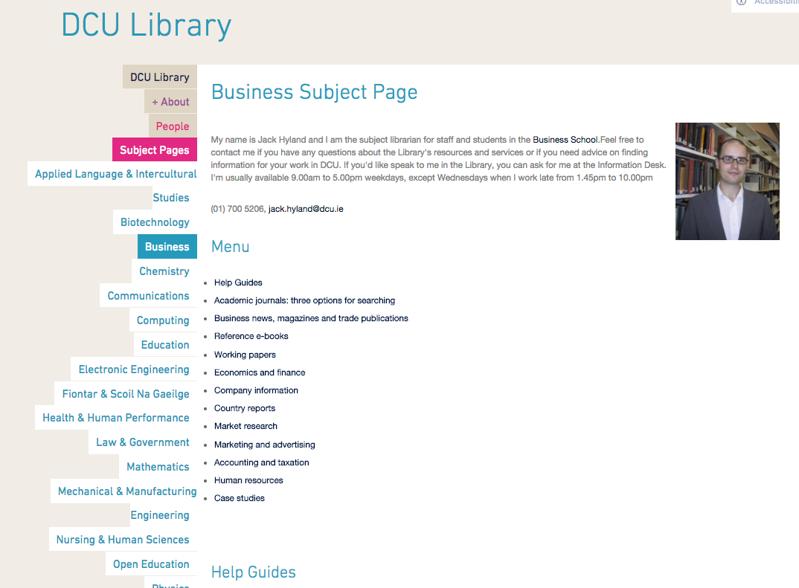
Background
What are we trying to achieve?

Slide 4
How we use Moodle - I
Activities
Plugins
Analysis

Slide 5
How we used Moodle - II

Slide 6
Plugins
Sub course plugin
- control the dissemination of the course content
Marking guide report plugin
- generates a report of all comments and scores for each criteria in the marking guide

Slide 7
Analysis

Slide 8
Next steps
We ask the lecturer to expand the number of levels in their marking guide
We examine students performance across a programme
We do a “before and after” citation and referencing test.

